Slide 1
Lecture 6
Measures of Spread

Slide 2
Review
1 One huge outlier is added to a dataset. Which moves more, the mean or the median?
The mean is pulled toward it. The median barely moves – it only cares about position in the ordered list.
2 Besides the sum over n, what were the other two ways we wrote the mean?
From a frequency table, and from a relative frequency table. All three give the same number.
3 What does it mean to say a score sits at the 75th percentile?
75 percent of the observations fall at or below that score.
4 You already have the median. How do you get Q1 and Q3 from it?
Q1 is the median of the lower half, Q3 the median of the upper half – leaving the median itself out of both halves when n is odd.

Slide 3
Review: quartiles of the exam scores
Last time you were asked for Q1, Q2 and Q3 of these 15 exam scores
  61 61 65 65 66 68 69 73 74 75 76 78 79 90 94
n is odd, so start at the median and work outward
Keep these three numbers - every example today uses them
Working:
Q2 is the median: with n = 15 that is the 8th value → Q2 = 73
lower half 61 61 65 65 66 68 69
its median → Q1 = 65
upper half 74 75 76 78 79 90 94
its median → Q3 = 78
The median itself belongs to neither half.

Slide 4
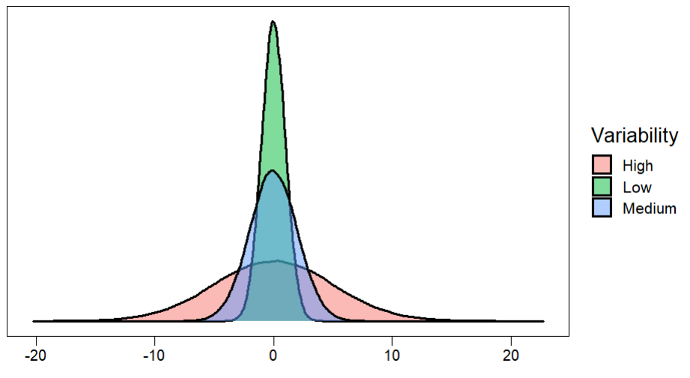
Variability of A Distribution: Measures of Spread

Slide 5
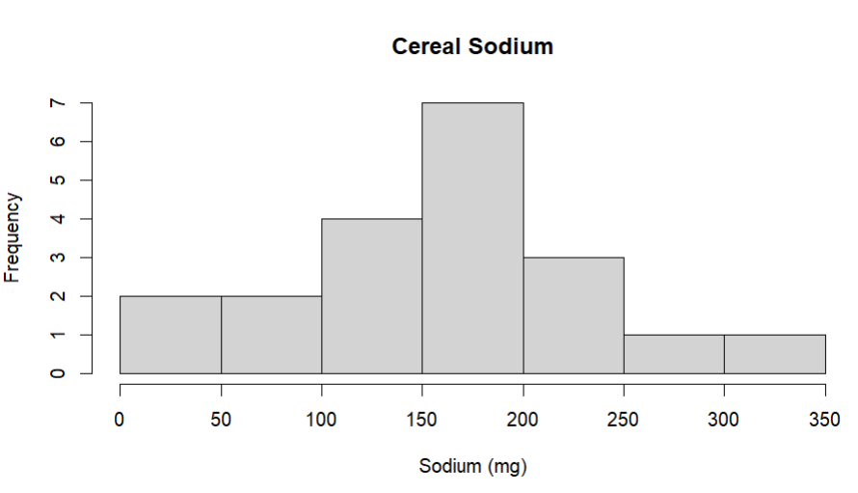
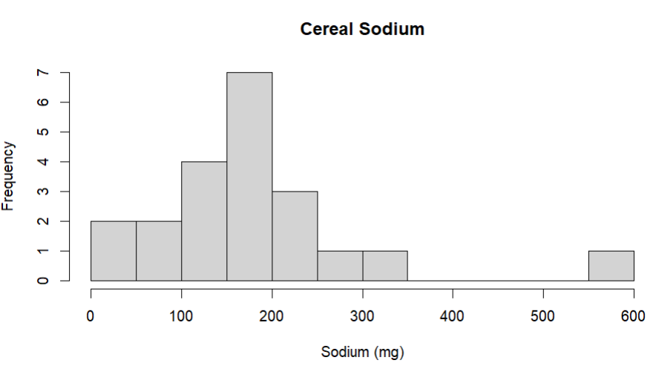
Measures of Spread: Range
The range is a measure of the distance between the smallest and largest values in the data
  The range can be computed with only two data points the minimum value and maximum value
If the range of a set of data is large, then usually this indicates greater dispersion of values
The range is severely affected by the presence of outliers
We typically do not use the range to measure variability

Slide 6

Measures of Spread: Interquartile Range
The interquartile range (IQR) measures the spread of the middle 50% of the observations
It is resistant to outliers
$$IQR=Q3 −Q1$$
The more variability the larger the value of the IQR
IQR is a good choice for distributions that are highly skewed!

Slide 7
Practice: Finding quartiles and IQR
Exam Scores 61,61,65,65,66,68,69,73,74,75,76,78,79,90,94
Compute the IQR
Working:
Q1 = 65 Q3 = 78 (from the review slide)
IQR = Q3 - Q1 = 78 - 65 = 13
The middle half of the class scored within 13 points of one another.

Slide 8

Measures of Spread: Deviation
A better measure of variability that uses all the data is based on deviations
deviations are the distances of each value from the mean of the data:
    Deviation of an observation$x_{i}=(x_{i} −\overline{x})$
Every observation will have a deviation from the mean

Slide 9
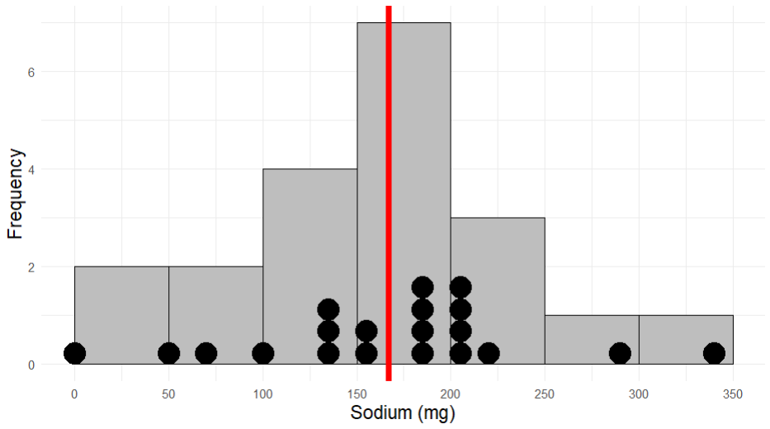
Frosted Mini Wheats = 0 (mg)
Mean = 167 (mg)
Rice Krispes = 340 (mg)
$$0 −167=−167$$
$$340 −167=173$$

Slide 10

Measures of Spread: Variance
The sum of all deviations is zero. $\sum_{i=1}^{n}{(x_{i} − \overline{x})}=0$
We typically use either the squared deviations or their absolute value
    Squared deviation of an observation $x_{i}= {\left(x_{i}− \overline{x}\right)}^{2}$
The Variance of a distribution is the average squared deviation from the mean
        $$S^{2}=\frac{1}{n−1}\sum_{i=1}^{n}{{\left(x_{i}−\overline{x}\right)}^{2}}$$
The sum $\sum_{i=1}^{n}{{\left(x_{i}−\overline{x}\right)}^{2}}$ is called the sum of squares

Slide 11
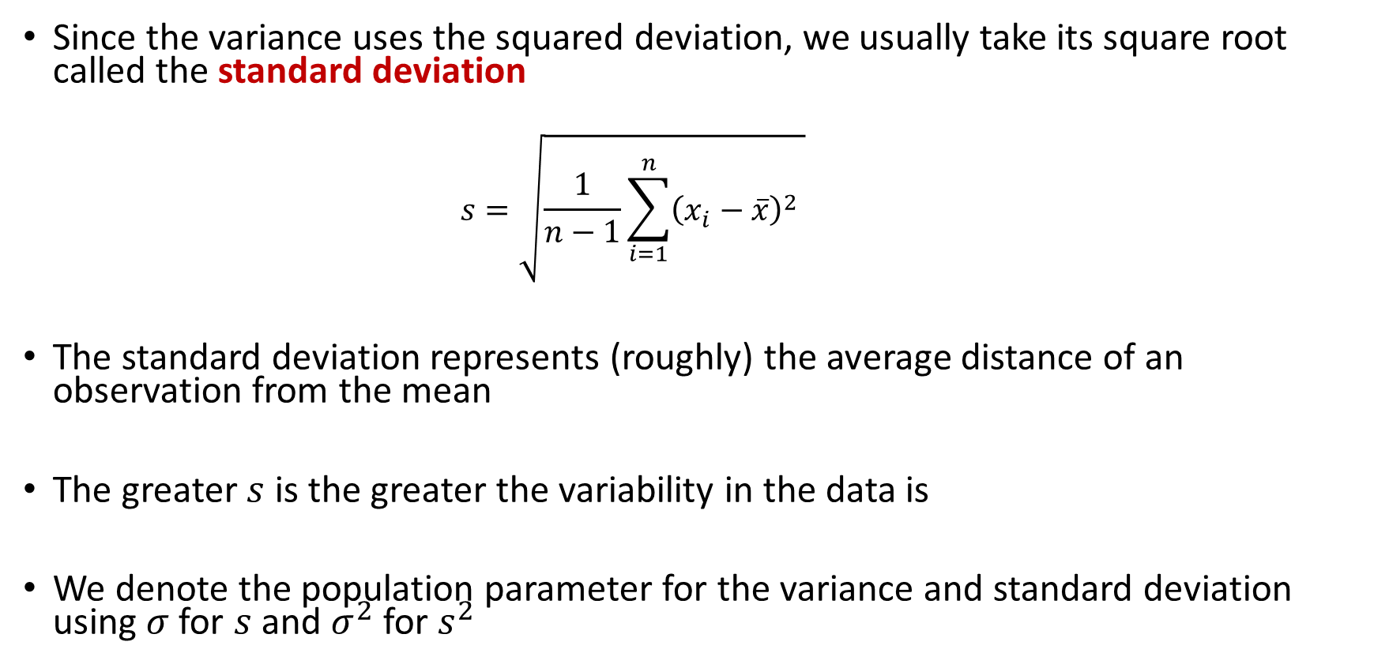
Measures of Spread: Standard Deviation
Since the variance uses the squared deviation, we usually take its square root called the standard deviation
    $$s=\sqrt{\frac{1}{n−1}\sum_{i=1}^{n}{{\left(x_{i}−\overline{x}\right)}^{2}} }$$
The standard deviation represents (roughly) the average distance of an observation from the mean
The greater $s$ is the greater the variability in the data is
We denote the population parameter for the variance and standard deviation using $σ$ for $s$ and $σ^{2}$ for $s^{2}$

Slide 12
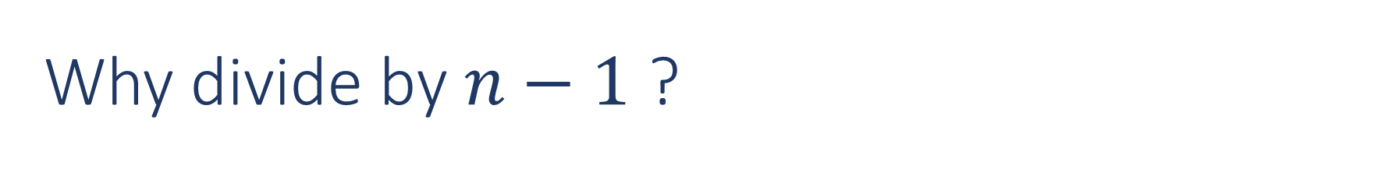
Why divide by $n−1$ ?
We divide by $n−1$ because we have only $n−1$pieces of independent information for $s^{2}$
Since the sum of the deviations must add to zero, then if we know the first $n−1$ deviations we can always figure out the last one
Ex.) suppose we have two data points and deviation of the first data point is $x −\overline{x}=−5$
  Then the deviation of the second data point has to be 5 for the sum of deviations to be zero.

Slide 13
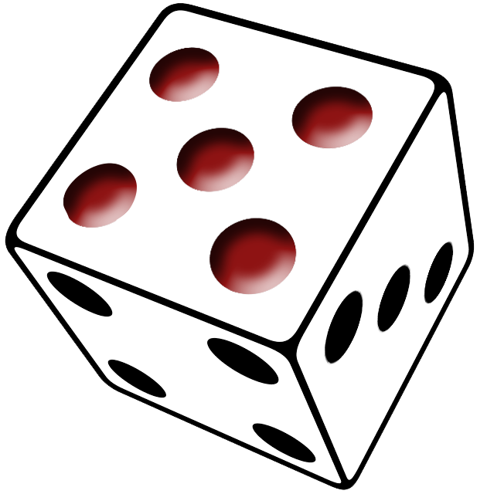
Try it out: computing the variance and standard deviation
Working:
deviations -2.8 -1.8 -0.8 -0.8 0.2 0.2 0.2 1.2 2.2 2.2
(they sum to 0, as they always must)
squared 7.84 3.24 0.64 0.64 0.04 0.04 0.04 1.44 4.84 4.84
sum of squares = 23.6
s² = 23.6 / (10 - 1) = 2.622
s = sqrt(2.622) = 1.619
s is back in pips; s² is in pips squared.
Roll a six-sided die $n=10$ times and record the number rolled each time
Data = 1,2,3,3,4,4,4,5,6,6
Mean = 3.8

Slide 14
Which measures do you report?
A center on its own does not describe a distribution - it needs a spread beside it, and the two come in matched pairs
  the mean and the standard deviation – both use every observation, so both are pulled by an outlier
  the median and the IQR – both are positions in the ordered data, so both are resistant
A measure is resistant when a single extreme observation barely moves it
Roughly symmetric, no outliers: report the mean and the standard deviation
Skewed, or outliers present: report the median and the IQR
Do not mix the pair. A mean next to an IQR describes two different things and answers neither question well.

Slide 15
The five number summary
Five numbers are enough to sketch a whole distribution
  Minimum Q1 Median Q3 Maximum
  For the 15 exam scores: 61 65 73 78 94
the median gives the center
Q1 and Q3 bracket the middle half, and their difference is the IQR
the minimum and maximum give the full extent
These five numbers are exactly what a boxplot draws

Slide 16
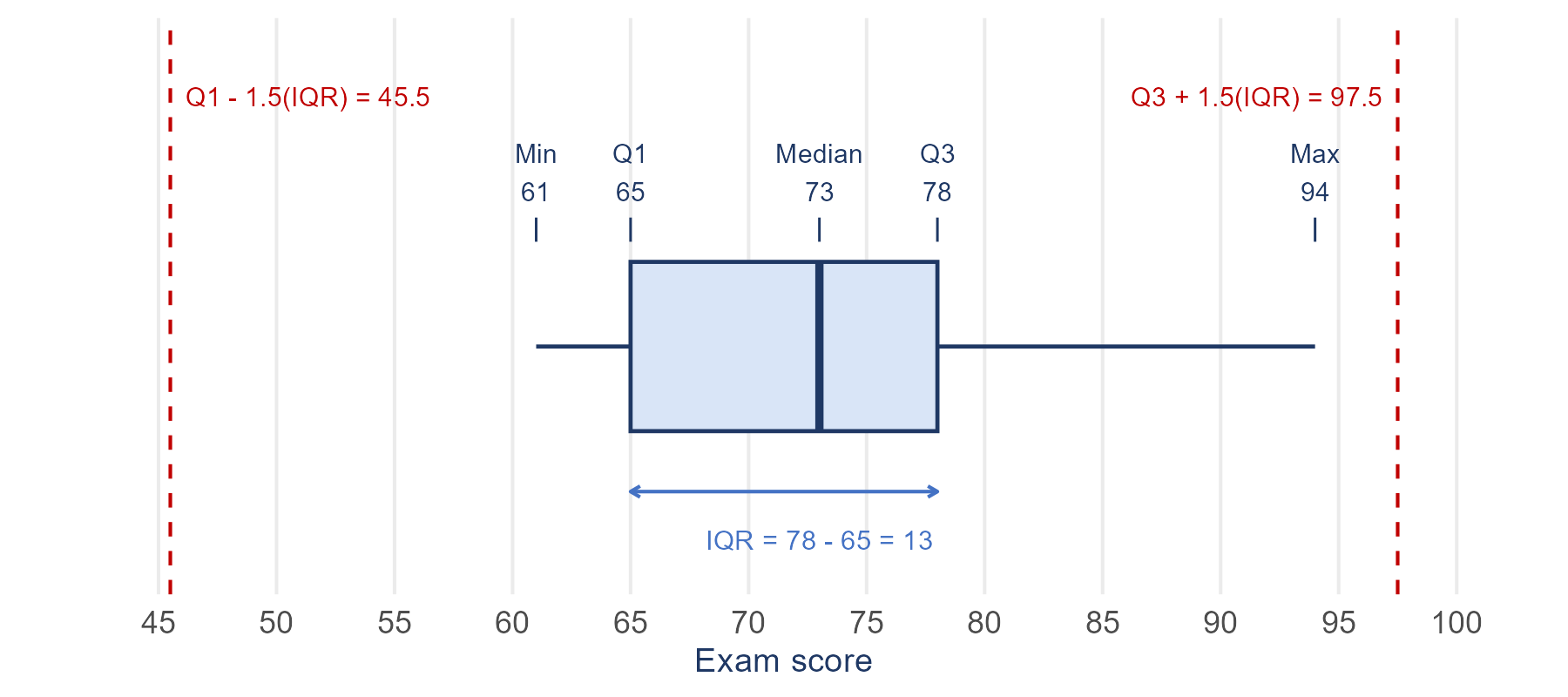
The Boxplot (Box and Whisker Plot): A five number summary
Pros:
  good for describing shape and location
  Can be used to identify outliers
  Length of whiskers indicates skew
  Good for comparing two distributions or across categories
Cons:
  does not show certain features like mounds, or gaps as well as a histogram

Slide 17
Identifying outliers: the 1.5 x IQR rule
We need a rule for "extreme" that does not depend on eyeballing the plot
The fences sit an extra one and a half IQRs beyond the box:
  Q1 - 1.5(IQR) and Q3 + 1.5(IQR)
Any observation outside a fence is an outlier, and gets plotted as its own point
The whiskers then stop at the most extreme observation INSIDE the fences - not at the minimum and maximum
The fences themselves are never drawn on the plot
Exam scores: 65 - 1.5(13) = 45.5 and 78 + 1.5(13) = 97.5, so nothing is flagged and the whiskers reach 61 and 94
Being flagged does not make an observation wrong. It makes it worth a second look.

Slide 18
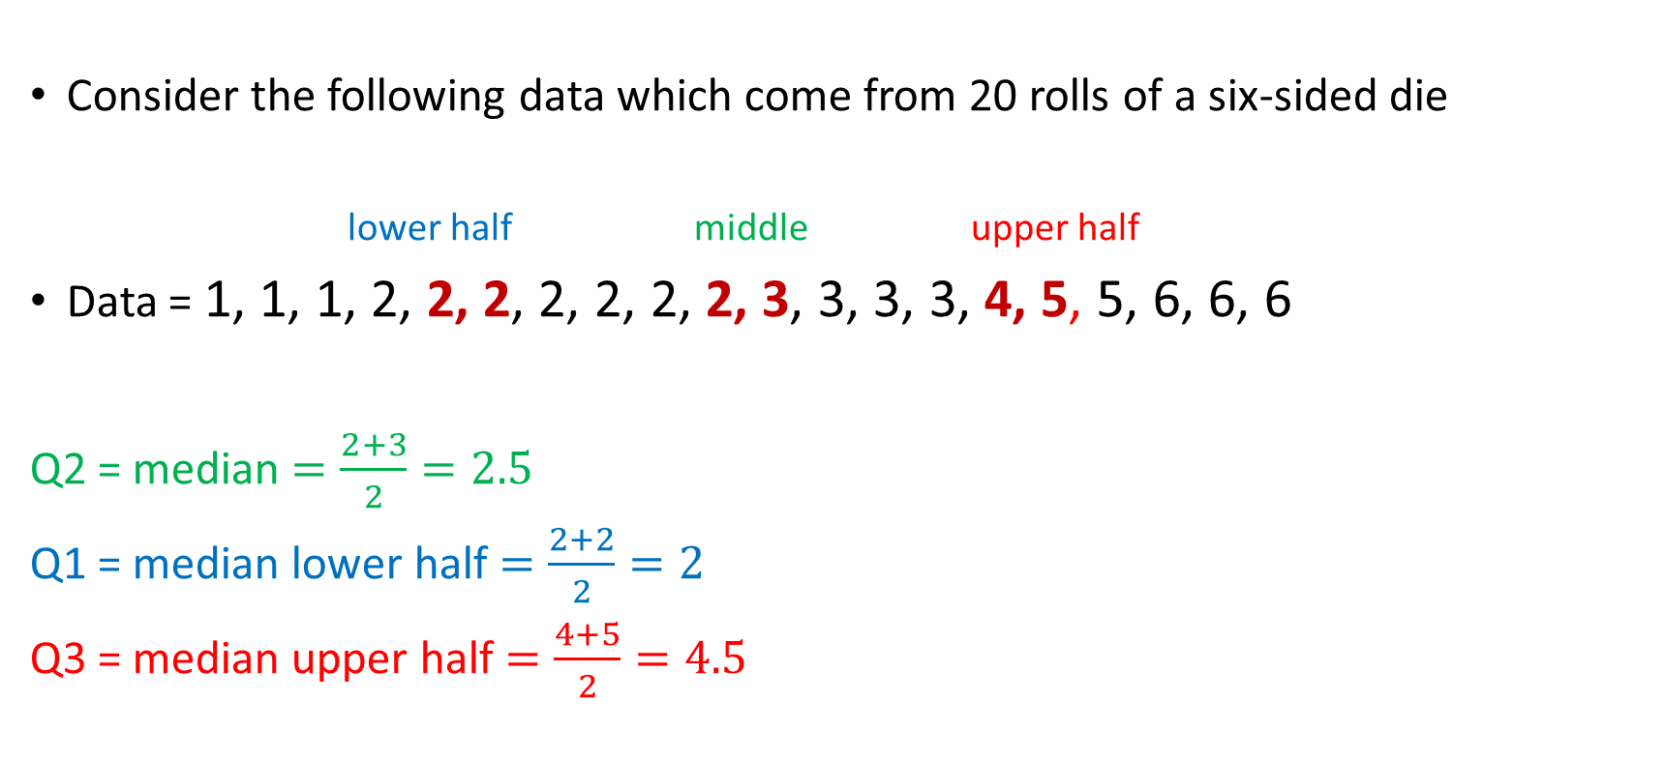
Ex. Construct a Boxplot
Consider the following data which come from 20 rolls of a six-sided die
lower half middle upper half
Data = 1, 1, 1, 2, 2, 2, 2, 2, 2, 2, 3, 3, 3, 3, 4, 5, 5, 6, 6, 6
Q2 = median $=\frac{2+3}{2}=2.5$
Q1 = median lower half $=\frac{2+2}{2}=2$
Q3 = median upper half $=\frac{4+5}{2}=4.5$

Slide 19
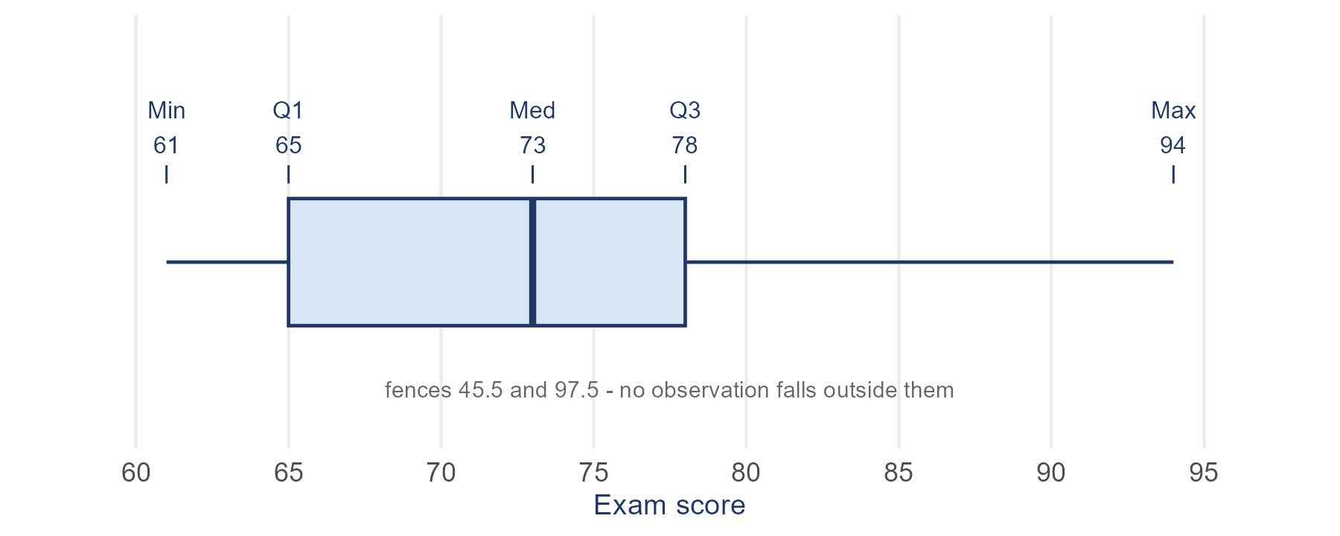
Practice: Construct a Boxplot
Construct the boxplot for student exam scores
Exam Scores 61,61,65,65,66,68,69,73,74,75,76,78,79,90,94

Slide 20
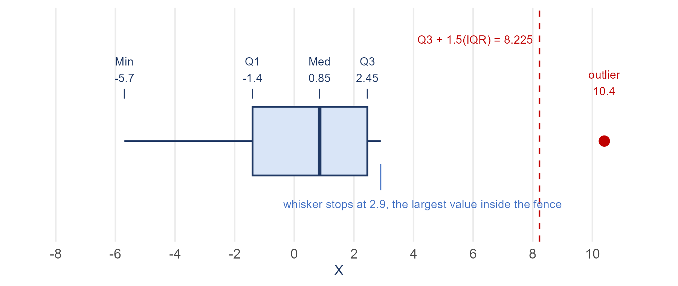
Ex2. Construct a Boxplot
Consider the following 12 observations of a quantitative variable X
X = { -5.7, -2.6, -1.5, -1.3, -0.4, 0.2, 1.5, 2.2, 2.3, 2.6, 2.9, 10.4 }
Compute the 5 number summary and draw a boxplot
Compare the IQR with the range

Slide 21
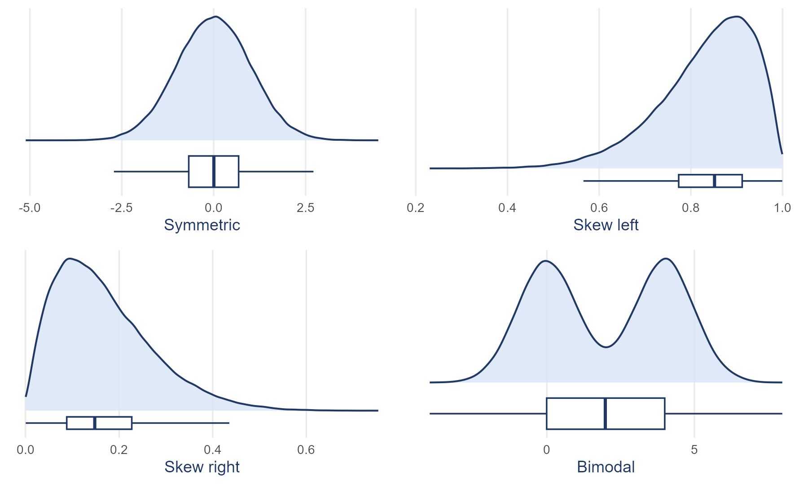
Whisker lengths show skew. But the bimodal panel has the same boxplot as a symmetric one - a boxplot cannot show peaks or gaps, so read it next to a histogram.

